Slide 1
Ocular Disease Recognition
Deep learning Mini Project
Name- Shreyas Mendhekar.
M-tech CSE, MT23MCS004

Slide 2
Problem Statement
Ophthalmologists use pattern recognition to identify disorders by looking at the eye and its surrounding tissues directly or indirectly.
Deep learning models can exploit that pattern in that images and can classify the images with respective type .

Slide 3
Dataset
Ocular Disease Dataset.
Ocular Disease Intelligent Recognition (ODIR) is a structured ophthalmic database of 5,000 patients with age, color fundus photographs from left and right eyes and doctors' diagnostic keywords from doctors.
Normal (N),
Diabetes (D),
Glaucoma (G),
Cataract (C),
Age related Macular Degeneration (A),
Hypertension (H),
Pathological Myopia (M),
Other diseases/abnormalities (O)
Dataset Link -https://www.kaggle.com/datasets/andrewmvd/ocular-disease-recognition-odir5k

Slide 4
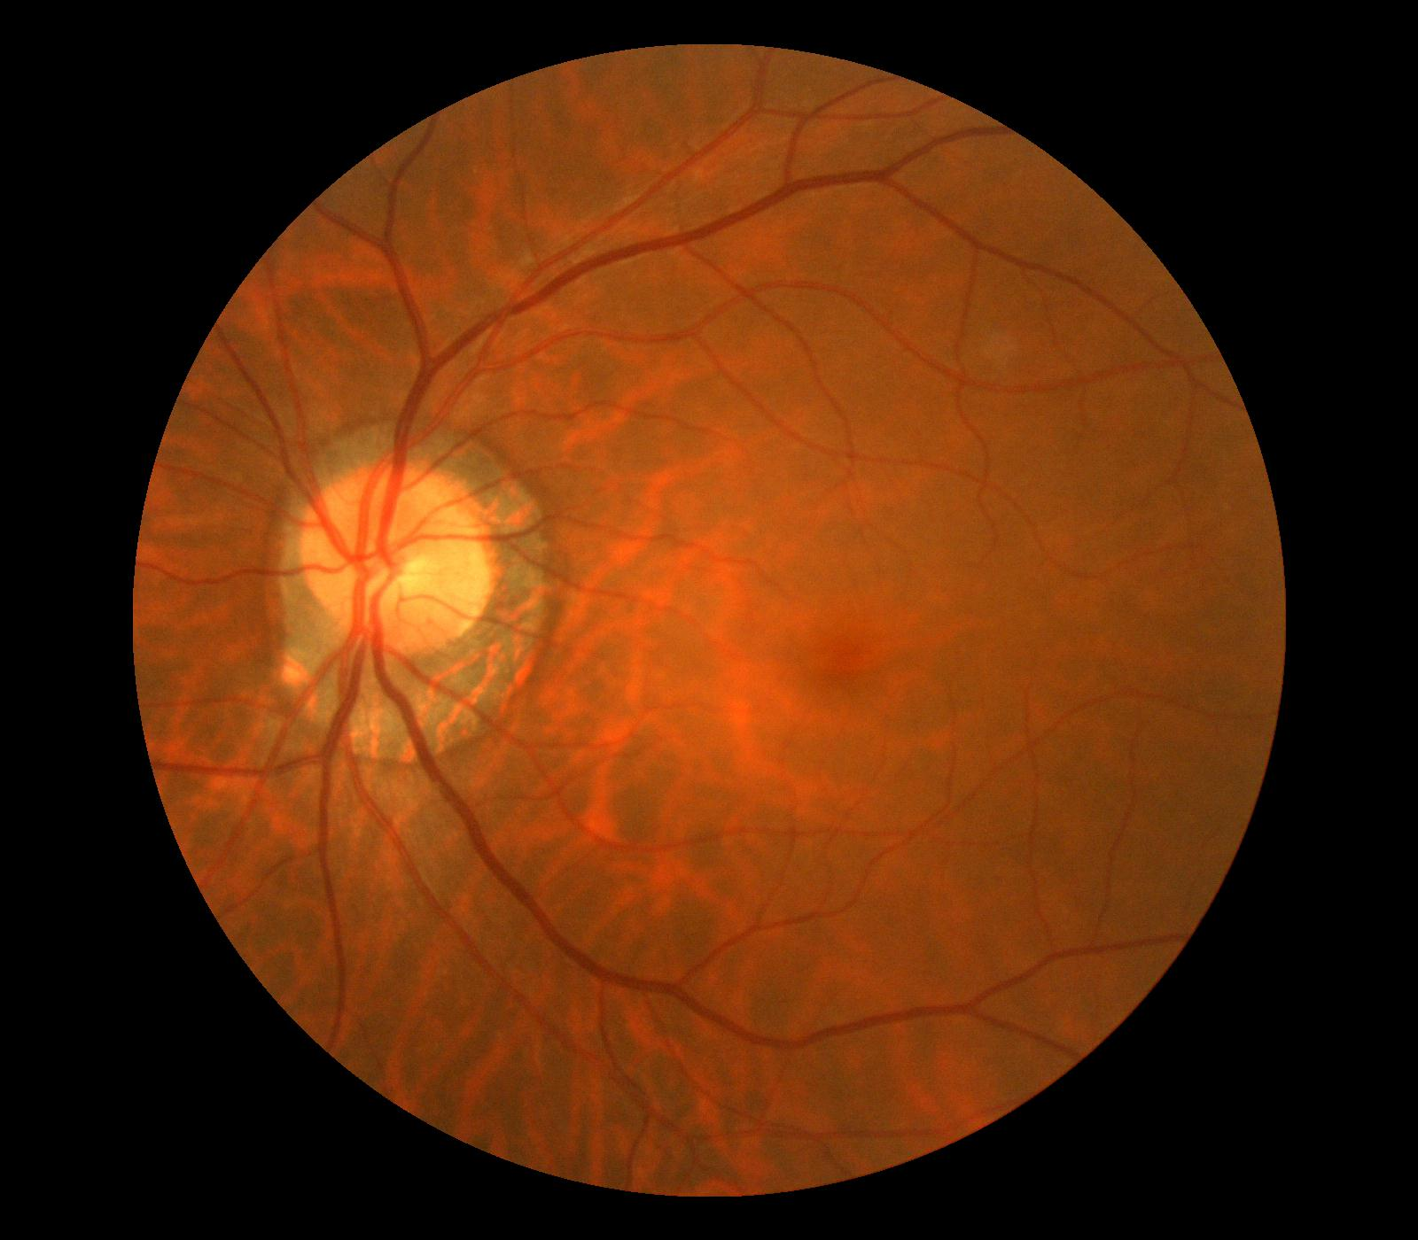
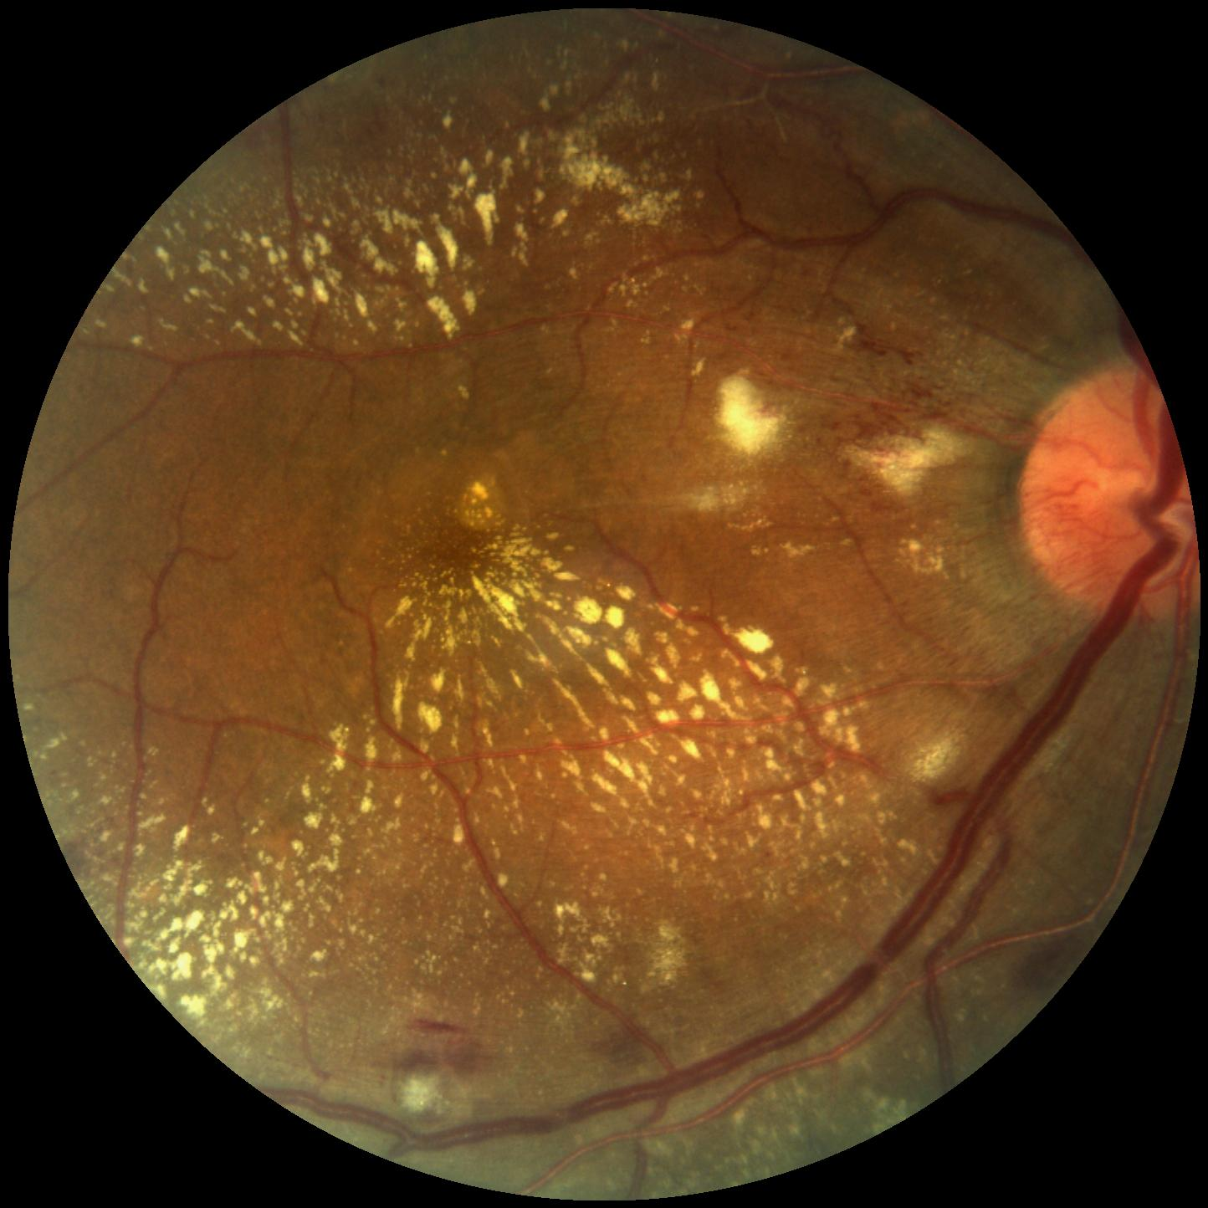
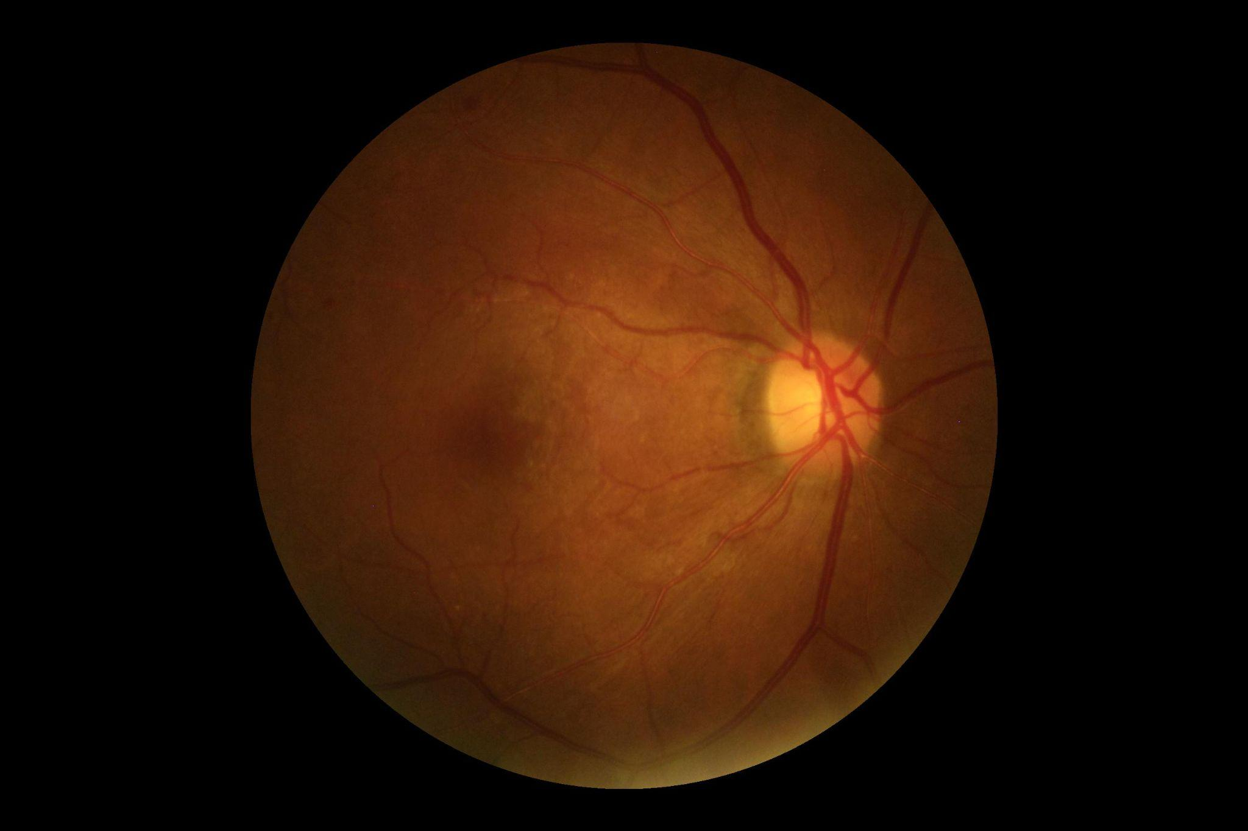
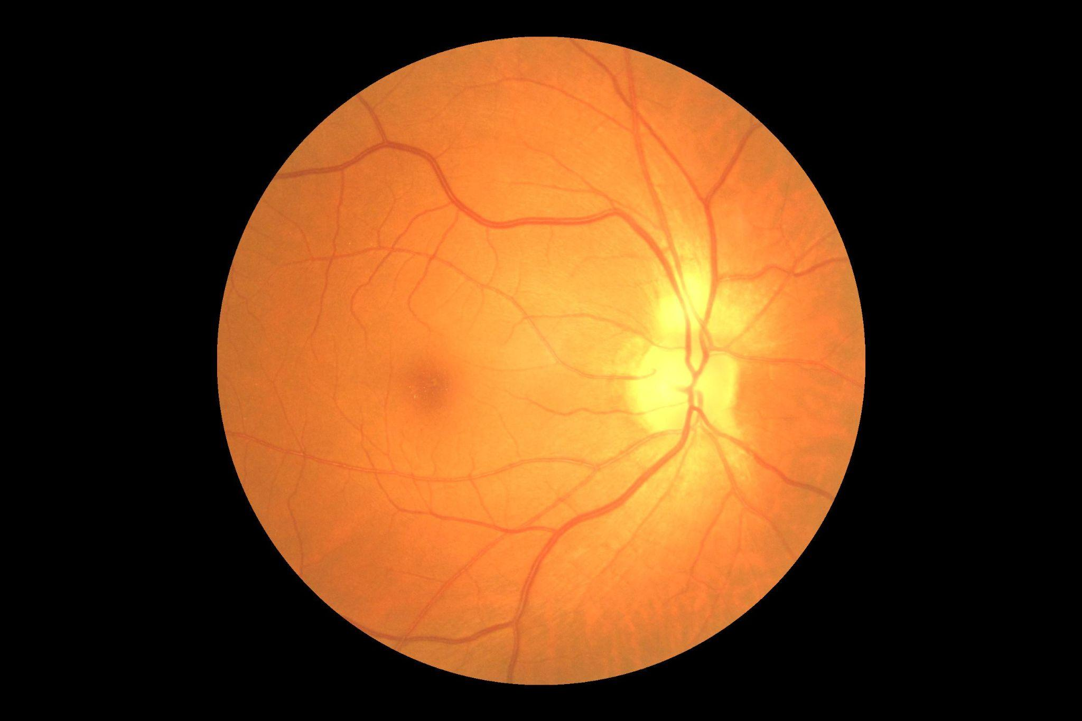
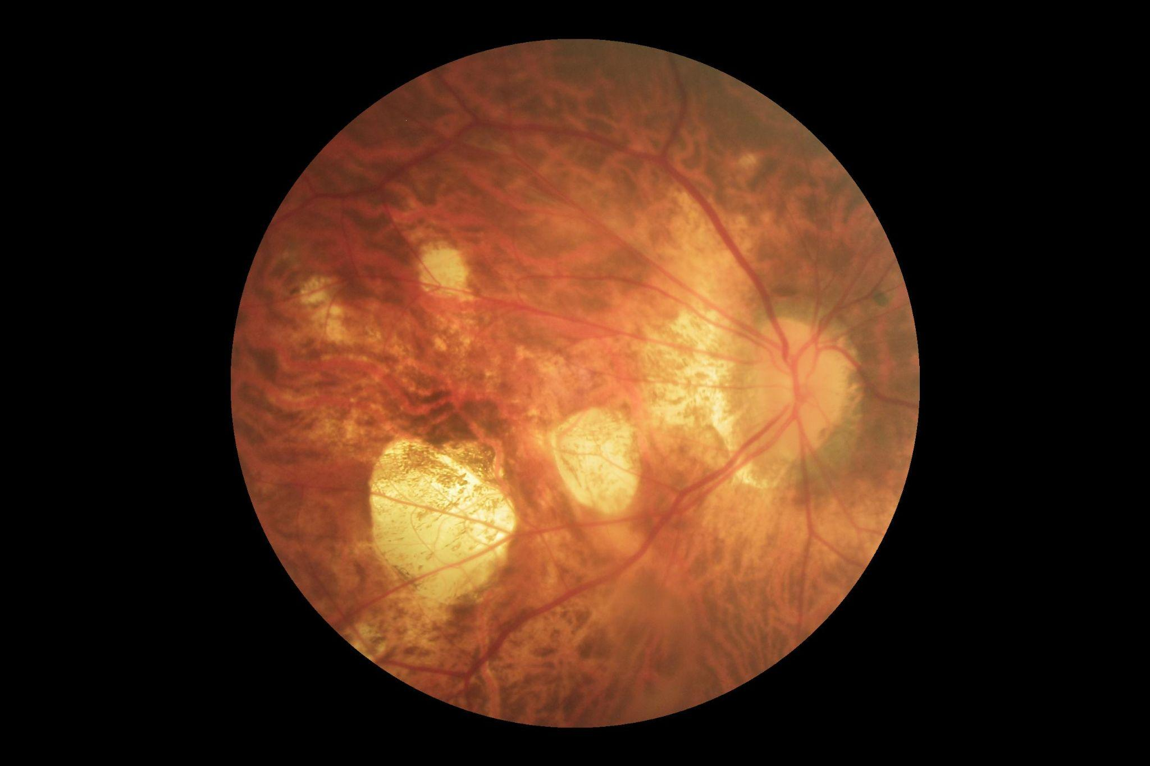
Dataset

Slide 5
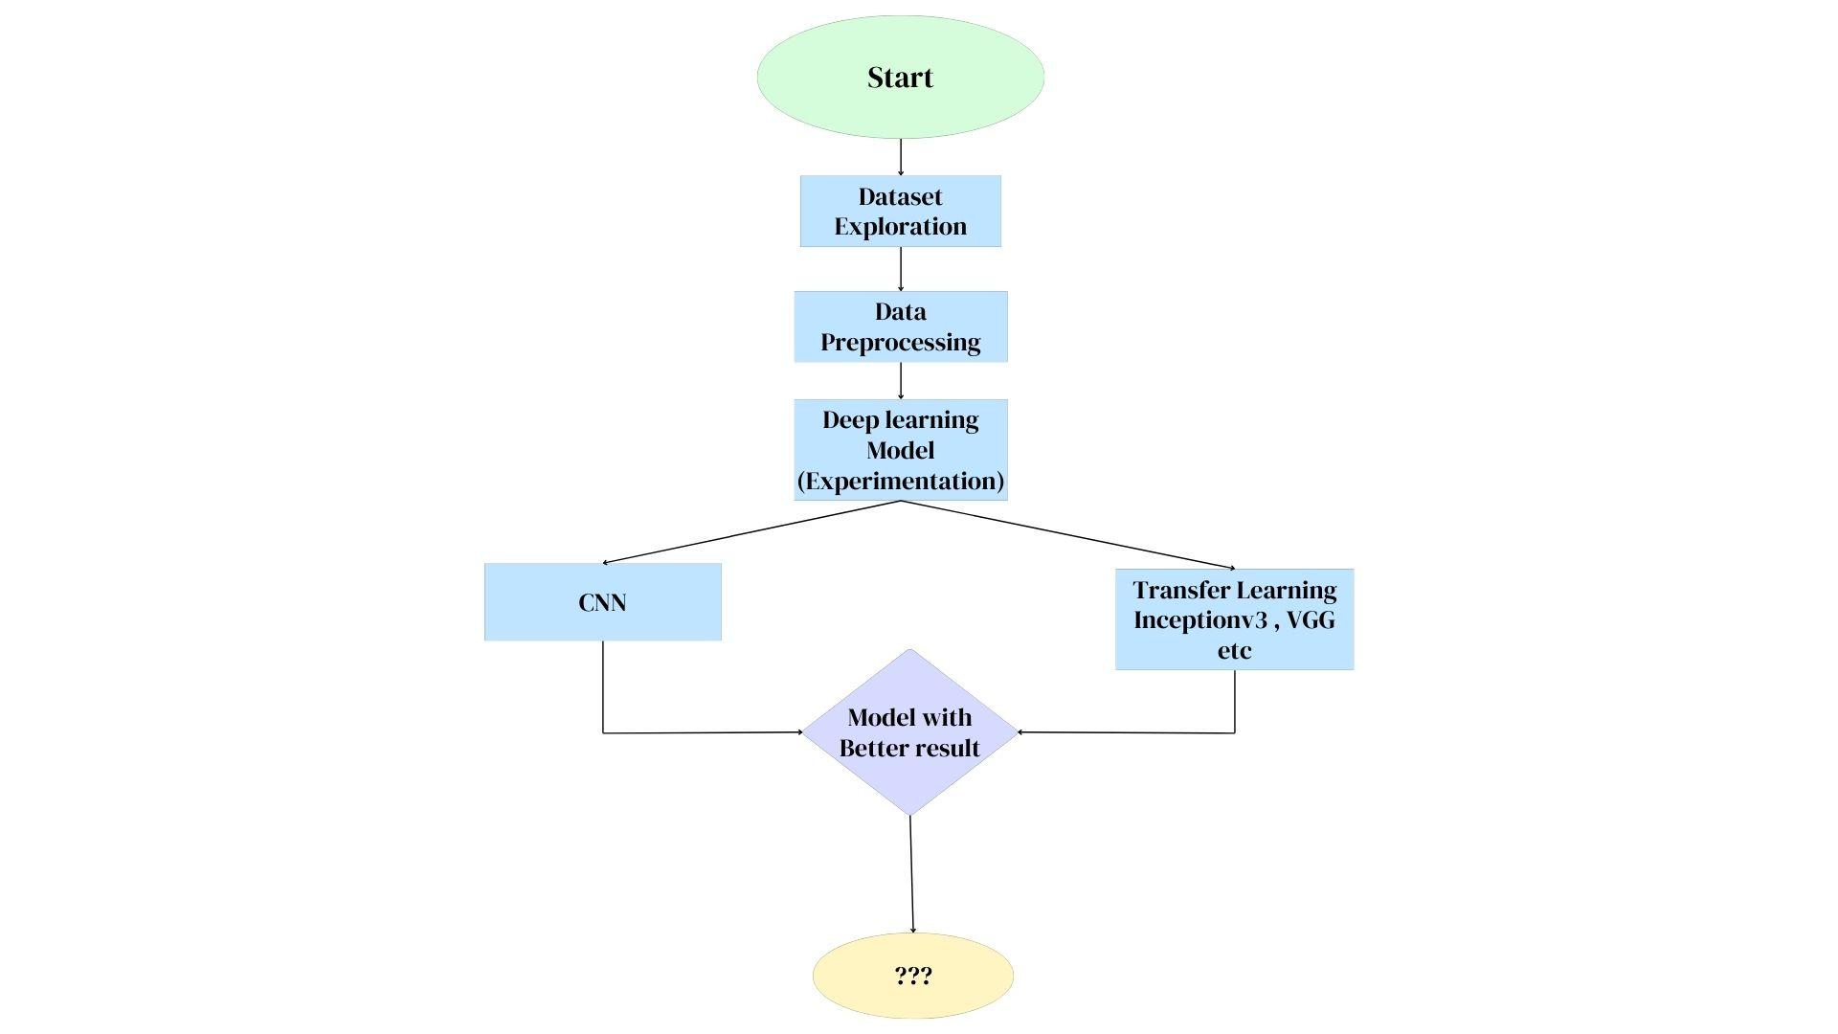
Flow Diagram

Slide 6
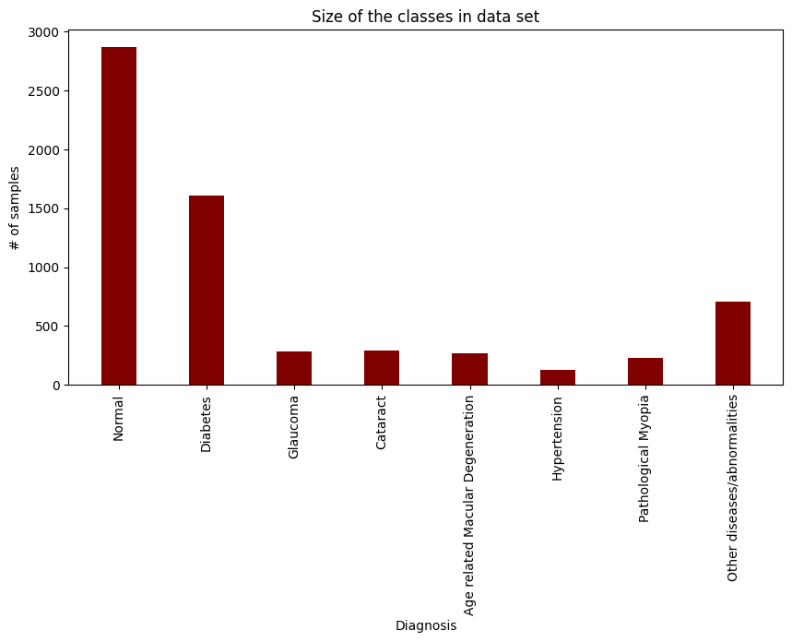
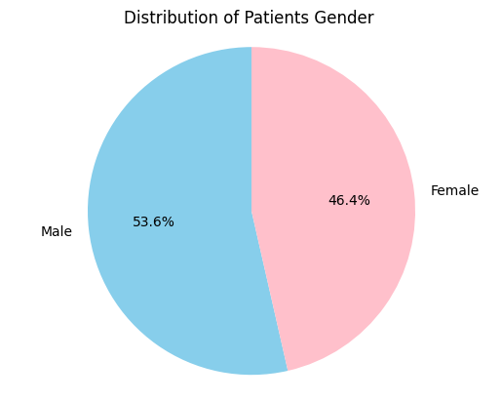
Data Analysis and Exploration

Slide 7
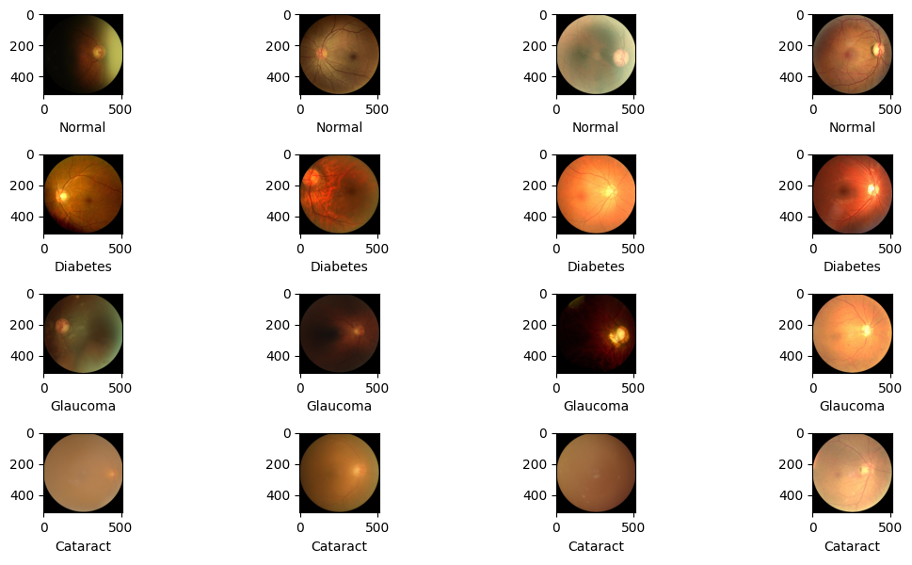
Preprocessed Data
Rescaling factor .
( According to the transfer learning model requirement)

Slide 8
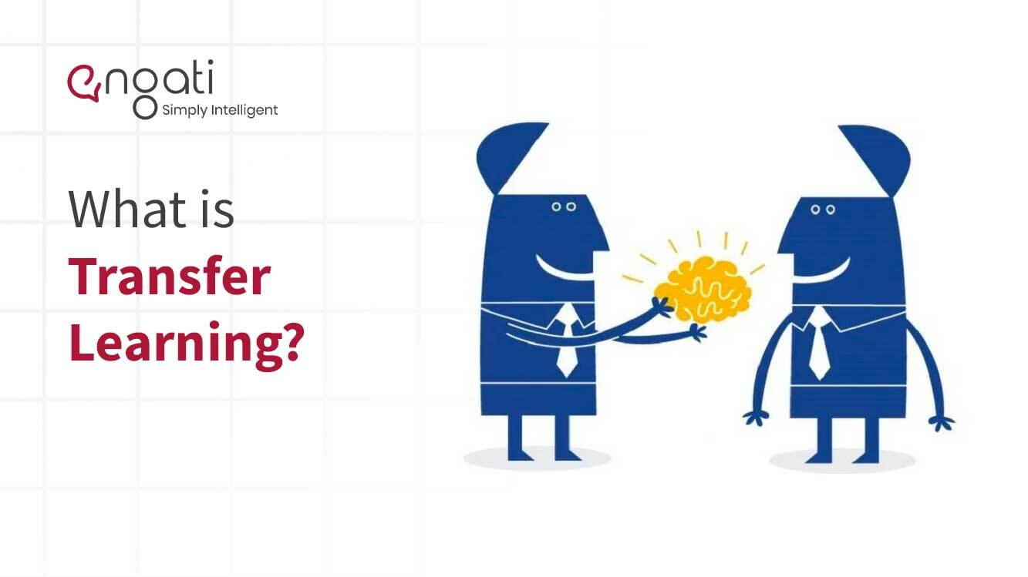
Transfer Learning
ResNet-50 is an image classification architecture introduced in 2015 and was trained on the ImageNet-1k dataset.
Pretrained model ResNet50 pretrained weights (PyTorch, AMP, ImageNet) downloaded
from Nvidia NGC. link

Slide 9
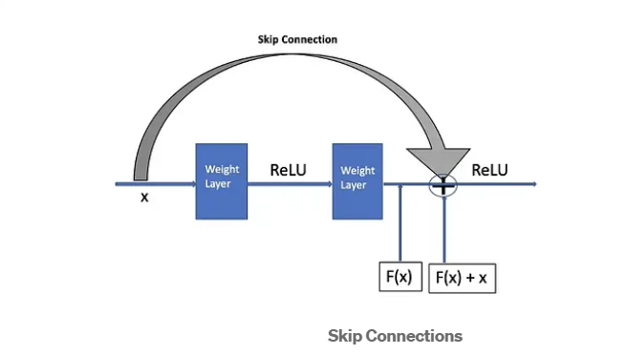
Resnet model
Residual Connections: ResNet incorporates residual connections, which allow for training very deep neural networks and alleviate the vanishing gradient problem.
A bottleneck residual block uses 1×1 convolutions,known as a “bottleneck”, which reduces the number of parameters and matrix multiplications.
Identity Block ( same size of
Input activation and output activation )
Convolution Block ( different size of
Input and output block )

Slide 10
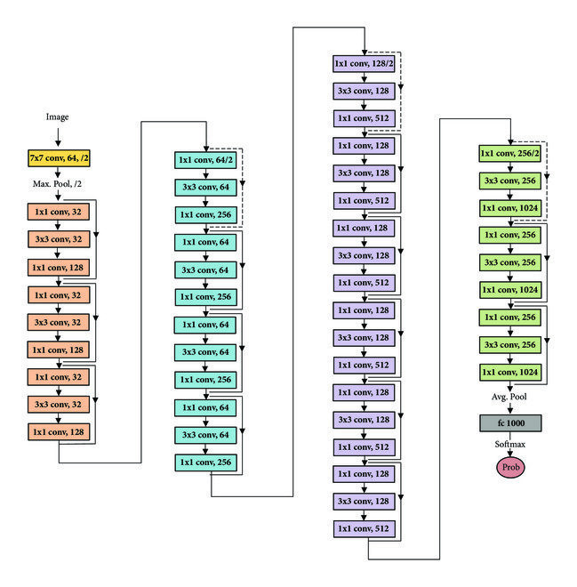
Architecture of Resnet

Slide 11
The 50-layer ResNet architecture includes the following elements, as shown in the table below:
A 7×7 kernel convolution alongside 64 other kernels with a 2-sized stride.
A max pooling layer with a 2-sized stride.
9 more layers—3×3,64 kernel convolution, another with 1×1,64 kernels, and a third with 1×1,256 kernels. These 3 layers are repeated 3 times.
12 more layers with 1×1,128 kernels, 3×3,128 kernels, and 1×1,512 kernels, iterated 4 times.
18 more layers with 1×1,256 cores, and 2 cores 3×3,256 and 1×1,1024, iterated 6 times.
9 more layers with 1×1,512 cores, 3×3,512 cores, and 1×1,2048 cores iterated 3 times.

Slide 12
Hyperparameters and Learnable parameters
Activation Function :-
Loss Function :- Cross Entropy.
Optimizers :- Adam .
Epochs :- 30
Batch Size - 32
Train test valid split - test - 20% , validation - 20%.
Learnable Parameters - 30 million .

Slide 13
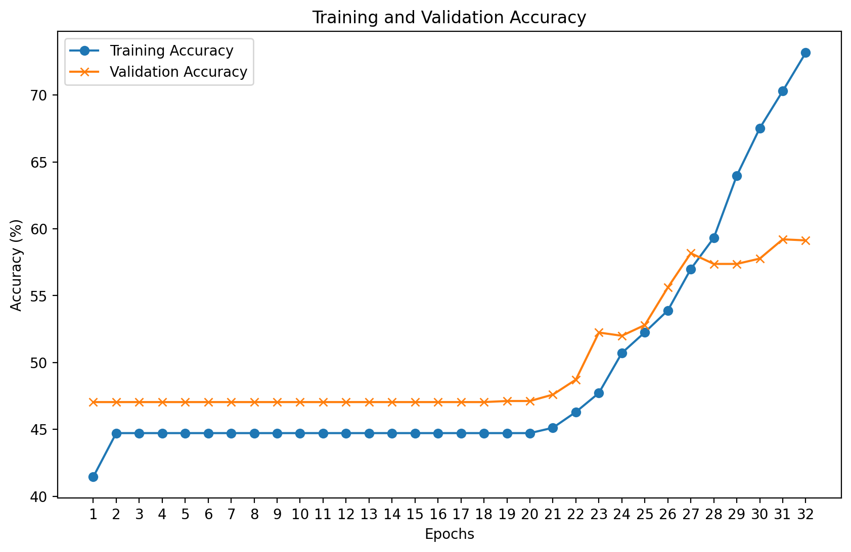
Model analysis metrics and loss function graph

Slide 14
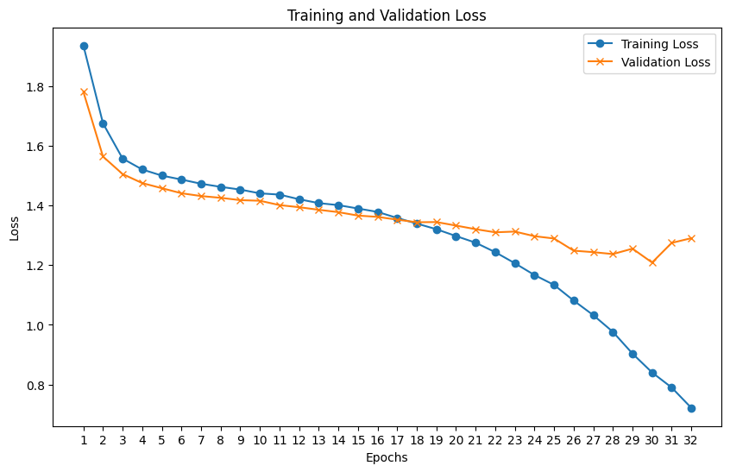
Model analysis metrics and loss function graph

Slide 15
References
"ResNet-50: The Residual Network Explained." (n.d.). Retrieved from https://datagen.tech/guides/computer-vision/resnet-50/#:~:text=ResNet%2D50%20is%20a%2050,networks%20by%20stacking%20residual%20blocks.
"NVIDIA NGC Models." (n.d.). Retrieved from https://catalog.ngc.nvidia.com/models?filters=&orderBy=weightPopularDESC&query=&page=&pageSize=
AnalyticsVidhya.(2021,October).UnderstandingTransferLearningforDeepLearning.Retrieved from https://www.analyticsvidhya.com/blog/2021/10/understanding−transfer−learning−for−deep−learning/
P. Nagpal, S. A. Bhinge and A. Shitole, "A Comparative Analysis of ResNet Architectures," 2022 International Conference on Smart Generation Computing, Communication and Networking (SMART GENCON), Bangalore, India, 2022, pp. 1-8, doi: 10.1109/SMARTGENCON56628.2022.10083966.

Slide 16
Thank YOU

